Slide 1
Predictors of an Institution’s Default rate/Repayment rate
By Berenger Djoumessi Tiague

Slide 2
Questions
What features best determine a cohort of student high vs low cohort default rate two years after entering repayment?
Can we classify schools with low vs high repayment from students with debt?

Slide 3
Data Cleaning Approach
Department of Education Scorecard datasets 97-2014
Concatenated all data
72032 observations and 1690 features
Drop all missing columns
Limited analysis only to 2012-2013 because of availability of data in most columns
15468 observations and 1321 features
Keep only columns with non-missing observations at least 10,000 or more.
15468 observations and 412 columns
Drop missing observations (not replacing missing by mean because not accurate)
5799 observations and 412 columns
Check and eliminate outliers
Heatmap, Pairplot, create subsets data

Slide 4
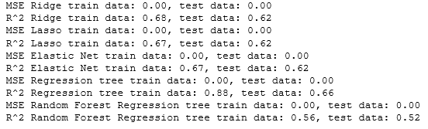
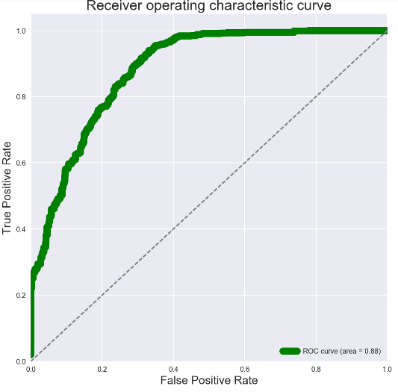

MODELS / MODEL EVALUATION
Dependent variable: Cohort Default rate two years after entering repayment.
Regularization methods: Ridge, Lasso, Elastic Net
Very close R-square and MSE on train and test.
Decision Tree and Random Forest applied: Not as close as the last three.
Classification : High vs Low repayment rate with threshold defined by literature (10%).
Precision score: 80%
Implemented PCA for practice purposes.
.

Slide 5
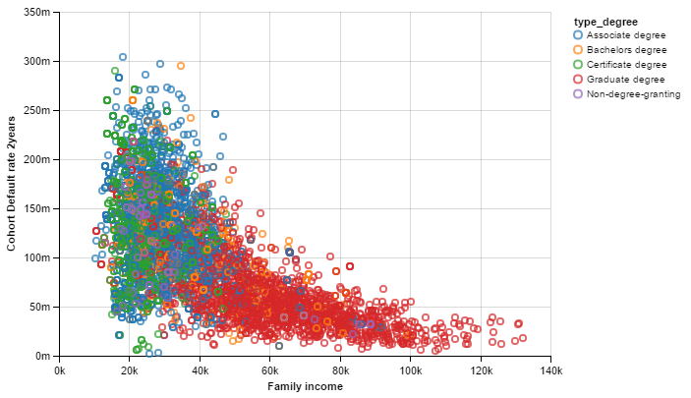
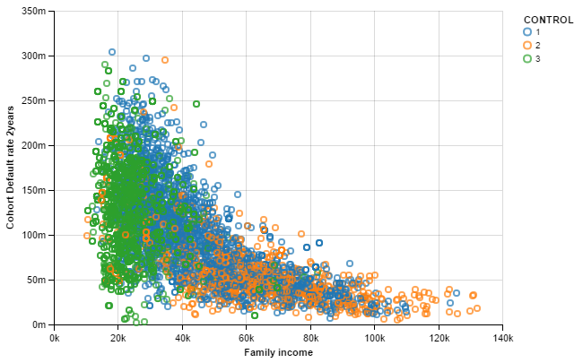
CONCLUSION
Best predictors of repayment rate : average family income of dependent student
consistent with the vast literature. Concluding how rich parents are determines access and outcomes.
Other predictors: number of Pell Grants applications in school and number of college’s branches.
Inequality in income is a major problem in American society because students from rich families have their ways to get richer, and it is hard for poorer students/families to get out of the poverty.
Graduate degree provide highest repayment rate.
Classified school with low vs high repayment with 80% accuracy
1 = Public
2 = Private Non Profit
3 = Private for Profit

Slide 6
RECOMMENDATIONS
Help students from disadvantaged backgrounds to get jobs after graduation via better networking.
Results suggest students should enroll more in private non-profit and get graduate degree.
Implement policies that decrease access and outcome gaps among students.
Collect data on longitude and latitude of schools, to perform a cluster classification (look on the US map to see whether we observe some patterns in some regions of the country).
Collect more data in the future, so possible to analyze over a longer period of time.

